Slide 1

Project Title - DSP & Analog Front End of Compact Short Range Frequency Modulated Continous Wave Radar
Motilal Nehru National Institute of Technology Allahabad
Department of Electronics & Communication Engineering
Project Presentation - 1
Group No - 40
Project Mentor - Dr. Yogendra Prajapati
Group Members - Subha Sarkar
Tushar Kumar
Ashish Kumar Jha

Slide 2
Motivation
Microwave radar are immune to weather conditions like fog, smoke, mist etc. It can detect moving objects behind a opaque object. Inteference from ambient noise is also less likely to happen.
A portable radar system can be used along with other sensors for better target detection in adverse weather condition like driving cars in foggy highway, surveillance using Unmanned Ground Vehicle etc.

Slide 3
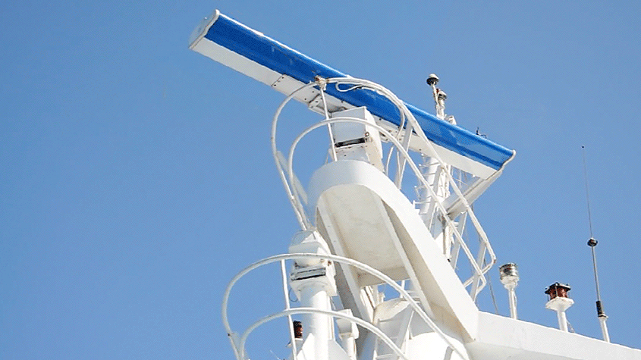
Radar (Radio Detection and Ranging)
Radar is a radiolocation technique in which a beam of radio waves emitted by a transmitter bounces off an object and returns to a receiver, allowing the location, range, speed, and other characteristics of the object to be determined.

Slide 4
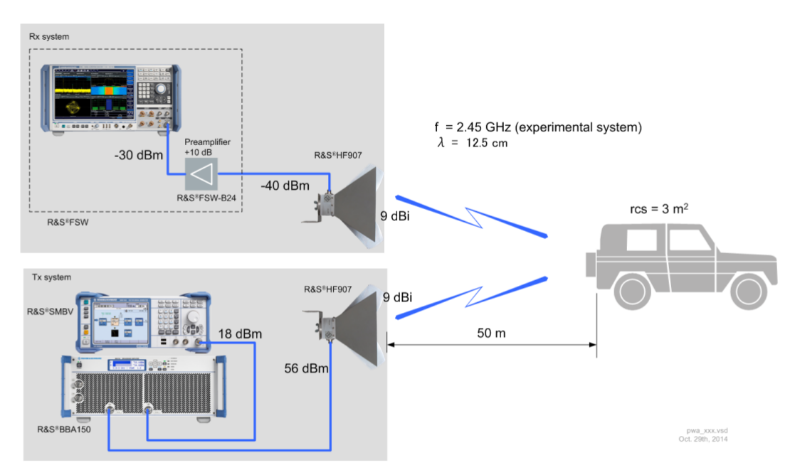
Typical Radar System

Slide 5
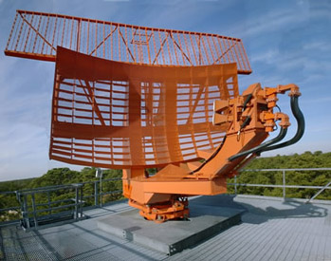
Why Microwave Radar ?
The short wavelength of microwaves causes large reflections from objects the size of motor vehicles, ships and aircraft.
Also, at these wavelengths, the high gain antennas such as parabolic antennas which are required to produce the narrow beamwidths needed to accurately locate objects are conveniently small, allowing them to be rapidly turned to scan for objects.

Slide 6
Doppler Radar
Doppler radar are used to detect moving targets. It does not responds to stationary target hence cannot be used for range measurements.
Doppler radar works on the basic principle of Doppler shift, where moving objects reflect back frequency shifted wave back to the transmitter and the analysis of beat frequency gives the target velocity.
To find range (distance) of the objects, it is required to modulate the VCO frequency with triangular signal. This is called FMCW radar.

Slide 7
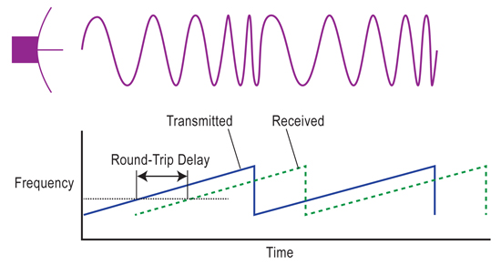
Basic Principle of FMCW radar

Slide 8
Methodology

Slide 9
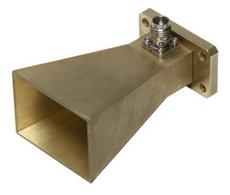
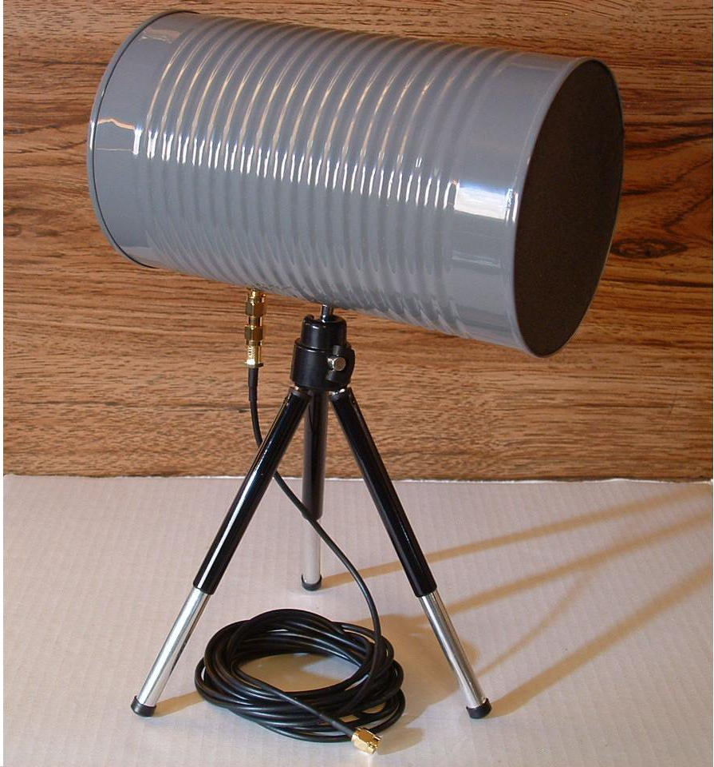
What we aim to do ?
We are aiming to design a radar operating at S-band frequency (2-4 GHz).
The front-end of the radar would be made using semiconductor ICs.
Patch array antennas / Cantenna / Horn waveguides would be made to be used as Rx/Tx antennas.
The signal captured out from mixer would be processed in Computer to determine range of a stationary target.

Slide 10
Components

Slide 11
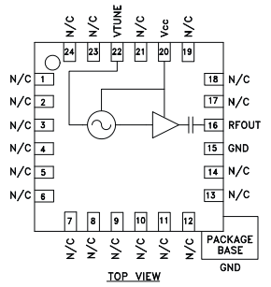
Voltage controlled Oscillator – HMC385/6
Frequency Range 2500 MHz – 2800 MHz
Tuning Gain 175MHz/V
Output Power -3dBm
Return Loss 12dB
Harmonics -30dBc
Frequency (supply) Pushing 1.3MHz/V
Frequency (Load) Pulling 4MHz @ VSWR 2:1

Slide 12
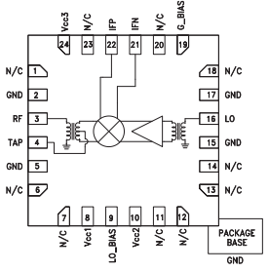
Passive Mixer – HMC689
Conversion loss = 7.5dB
Input IP3 = 32dBm
LO drive level = 0dBm

Slide 13
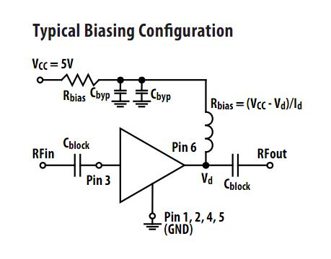
RF Amplifier and LNA - AVT51663
Gain 19.6dB
OIP3 25.1dBm
Noise Figure 3.2dB
P1dB 12.9dBm

Slide 14
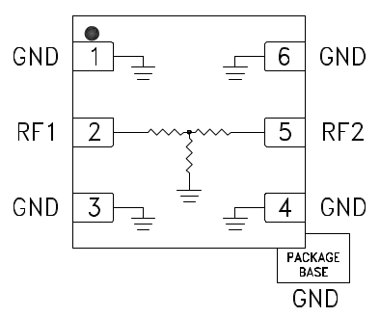
RF Attenuators

Slide 15
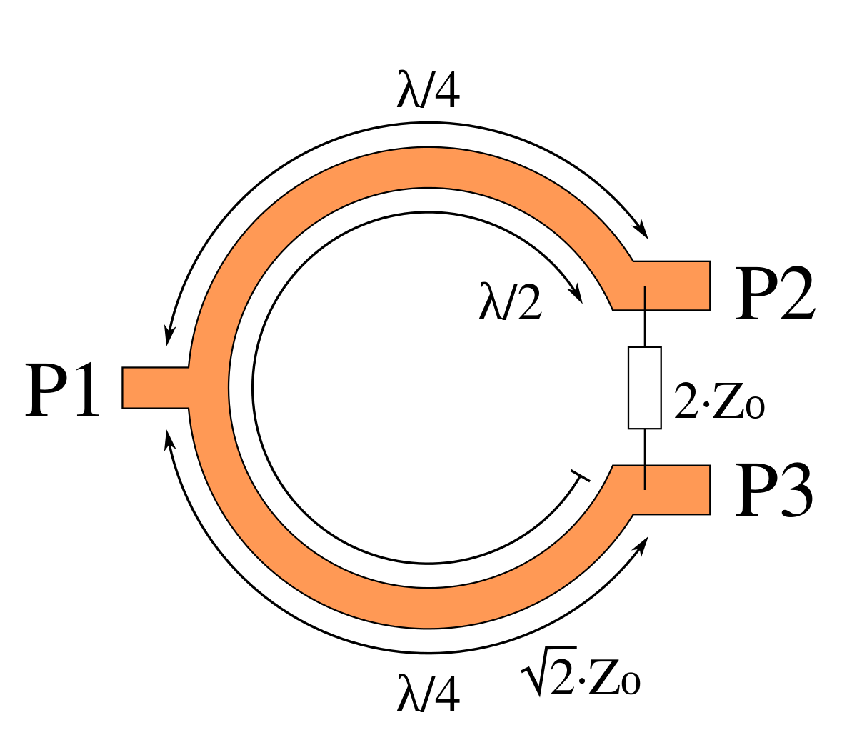
Wilkinson Power Divider

Slide 16
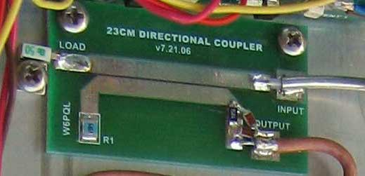
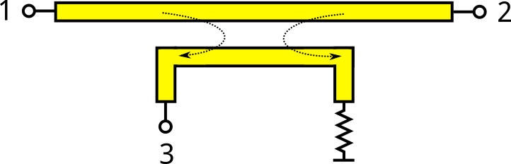
Directional Coupler

Slide 17
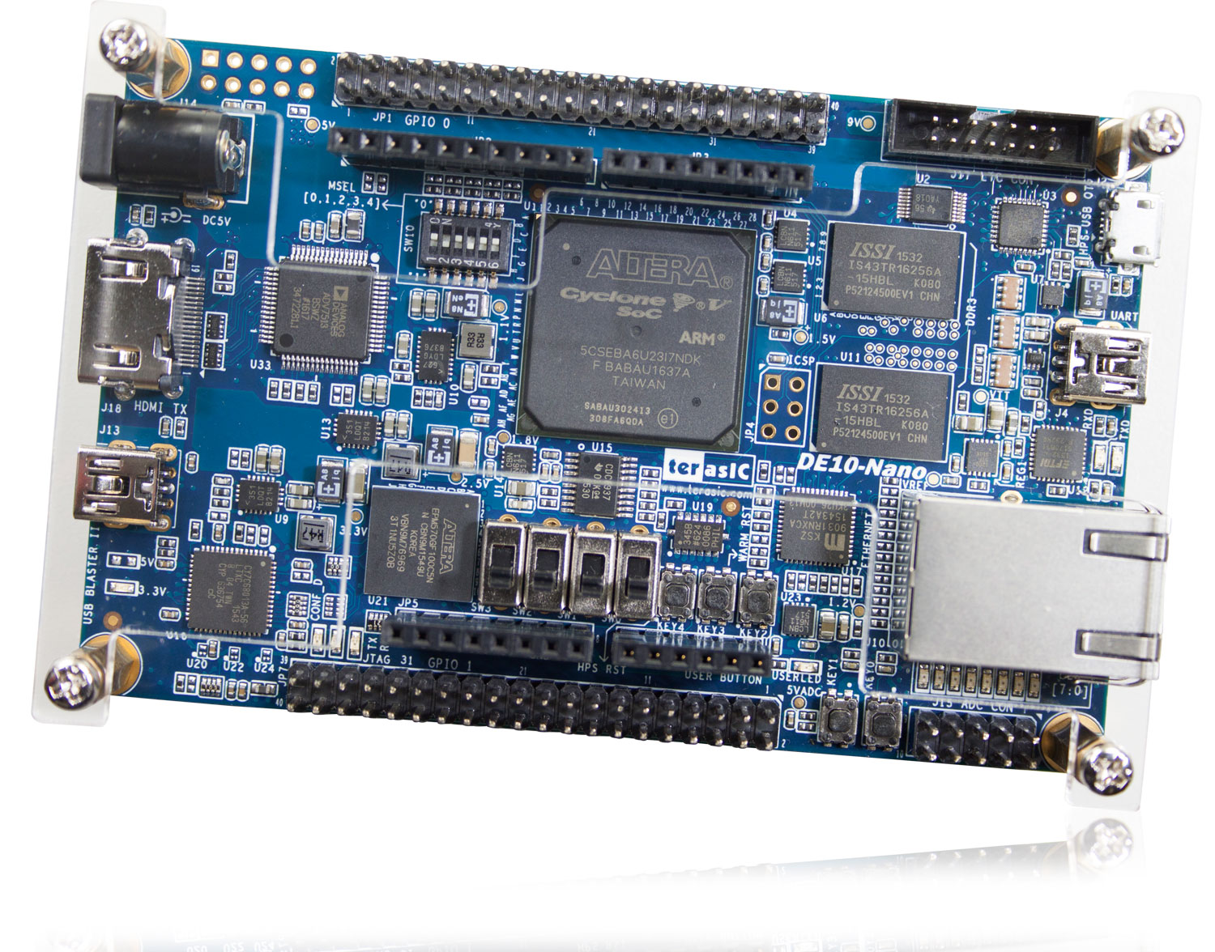
Computation Platform
After prototyping in Laptop/PC we plan to use Altera Cyclone V SoC

Slide 18
What we plan to do next !
Design the schematics and layout of all the major components and fabricate PCBs
Test the PCBs for proper functionality and adherence to theoretical values

Slide 19
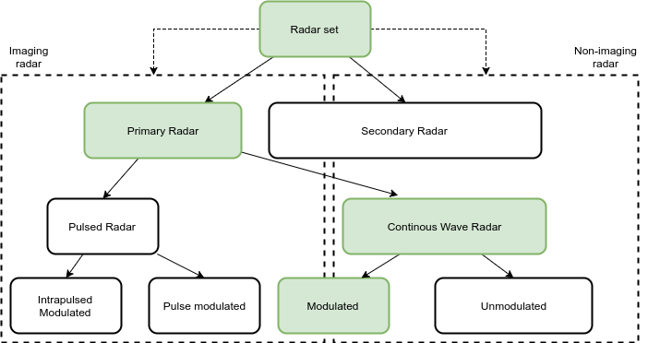

Slide 20
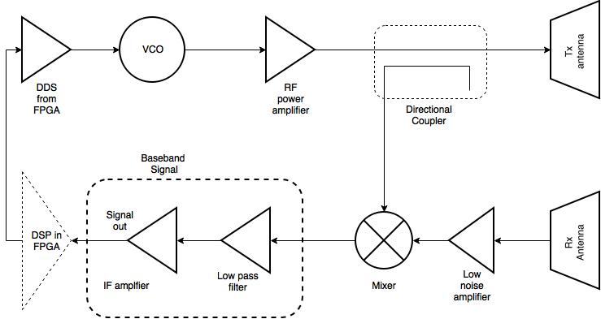

Slide 21

Radar link budget
A simplified version of the link budget equation is given below :
${ P}_{r}$ = $\frac{P_{t}G^{2}\text{σ}{\text{λ}}^{2}\text{τ}}{{(4π)}^{3}R^{4}}$
$P_{t}$ = Peak transmit power = 15dBm = 31.6mW
G = Gain of the antenna = 10dB
$\text{σ}$= Radar cross section or area of the target = 1$m^{2}$
λ = Radar wavelength(assuming centre frequency to be 2.5GHz) = 12cm
τ = Duty cycle of the transmitter = 1
R = Range of the target = 1m to 40m
Putting these values we obtain
$P_{\begin{aligned}r,min \\ \end{aligned}}$ = 8.957$×{10}^{−12}W$= $−$80.478dBm
$P_{r,max}$ = 2.29$×{10}^{−5}$W = $−16.39dBm$

Slide 22
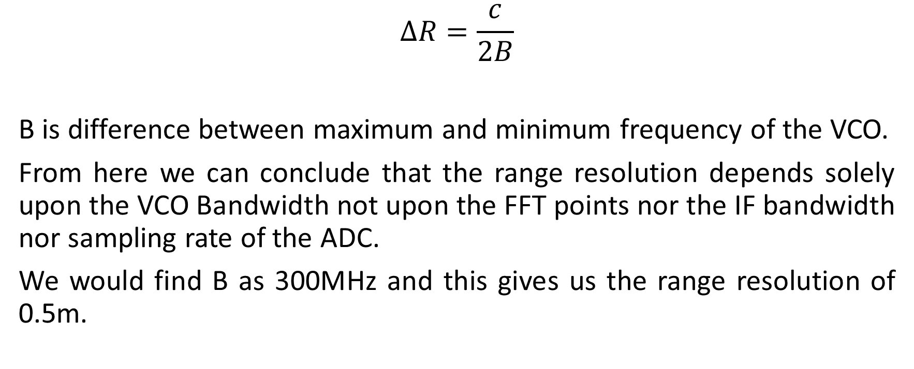
Range resolution
$$∆R=\frac{c}{2B}$$
B is difference between maximum and minimum frequency of the VCO.
From here we can conclude that the range resolution depends solely upon the VCO Bandwidth not upon the FFT points nor the IF bandwidth nor sampling rate of the ADC.
We would find B as 300MHz and this gives us the range resolution of 0.5m.

Slide 23
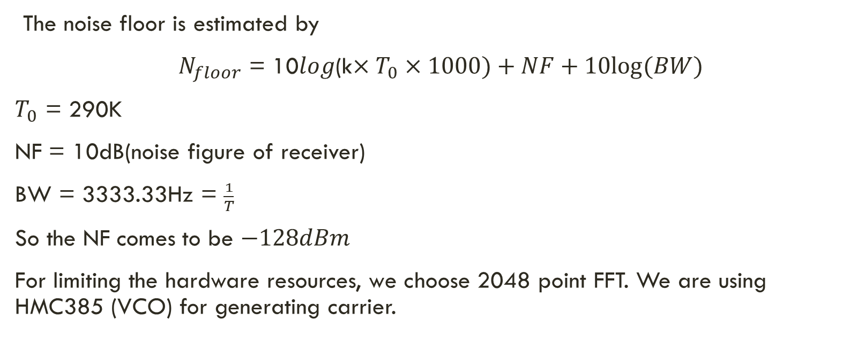
Estimating noise floor
The noise floor is estimated by
${ N}_{floor}$ = 10$log$(k$×T_{0}×1000)+NF+10log⁡(BW)$
$T_{0}$ = 290K
NF = 10dB(noise figure of receiver)
BW = 3333.33Hz = $\frac{1}{T}$
So the NF comes to be $−128dBm$
For limiting the hardware resources, we choose 2048 point FFT. We are using HMC385 (VCO) for generating carrier.

Slide 24
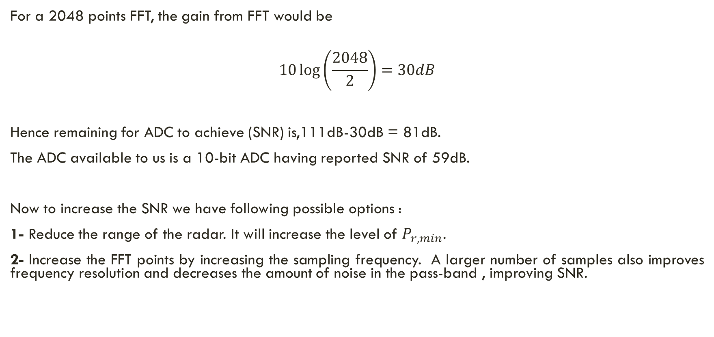
Choosing an ADC
For a 2048 points FFT, the gain from FFT would be
$$10\log\left(\frac{2048}{2}\right)=30dB$$
Hence remaining for ADC to achieve (SNR) is,111dB-30dB = 81dB.
The ADC available to us is a 10-bit ADC having reported SNR of 59dB.
Now to increase the SNR we have following possible options :
1- Reduce the range of the radar. It will increase the level of $P_{r,min}$.
2- Increase the FFT points by increasing the sampling frequency. A larger number of samples also improves frequency resolution and decreases the amount of noise in the pass-band , improving SNR.

Slide 25
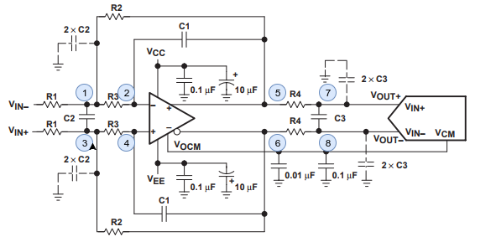
Fully Differential Amplifier

Slide 26
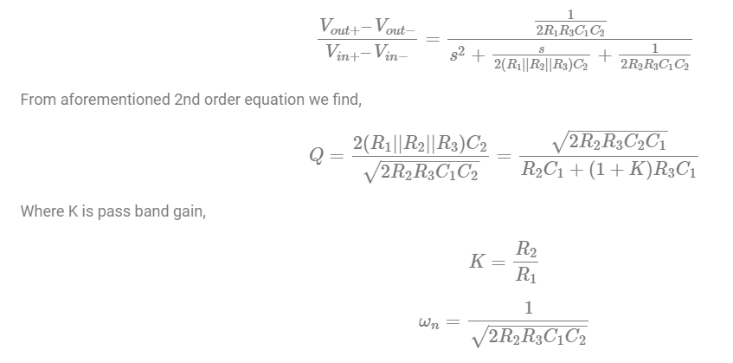
Transfer function of FDA

Slide 27
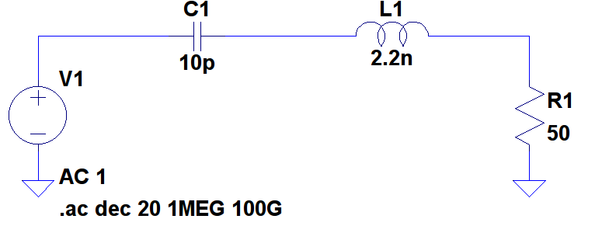
RF Band Pass filter

Slide 28
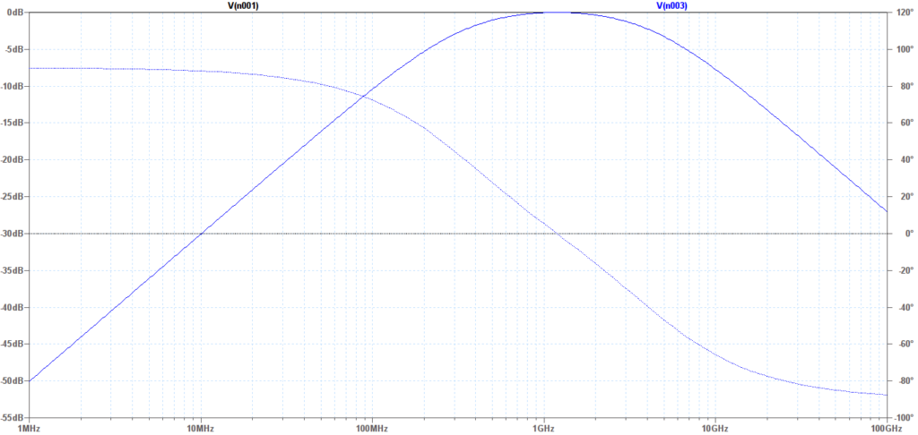
Frequency Response of BPF

Slide 29
LNA - PA

Slide 30
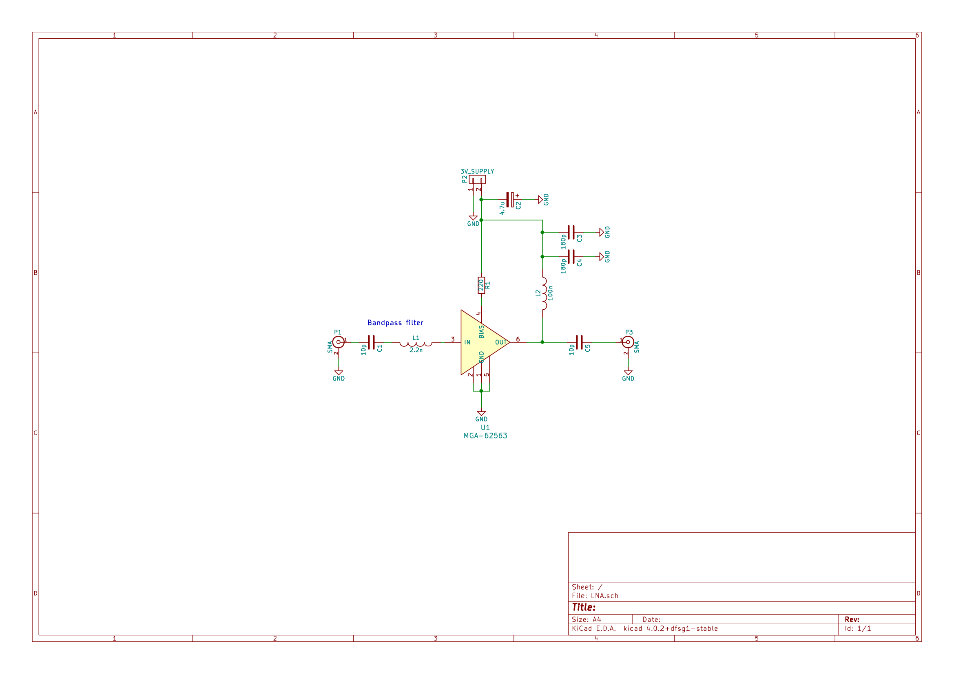

Slide 31
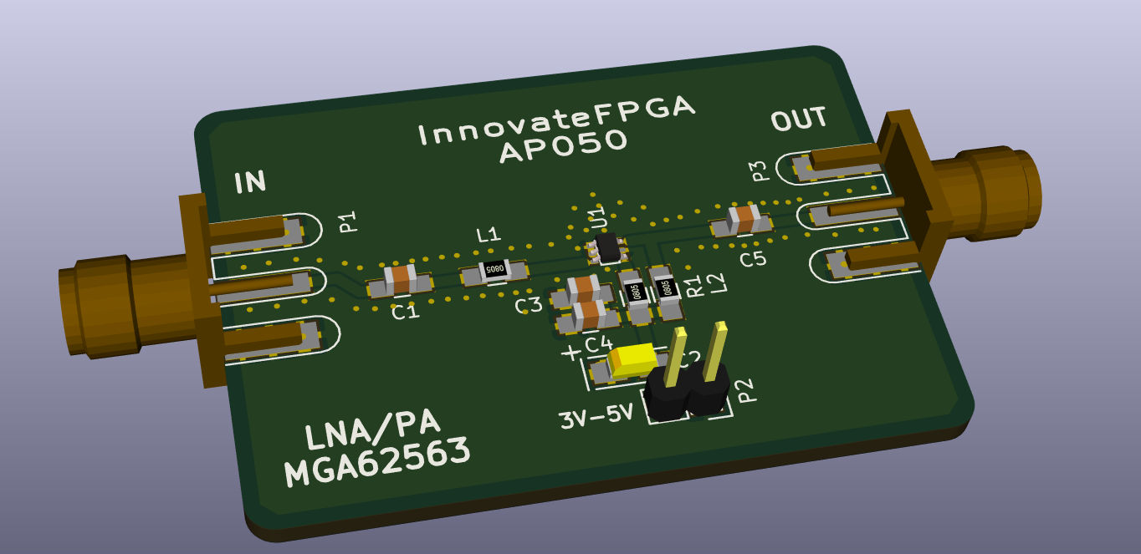

Slide 32
Mixer

Slide 33
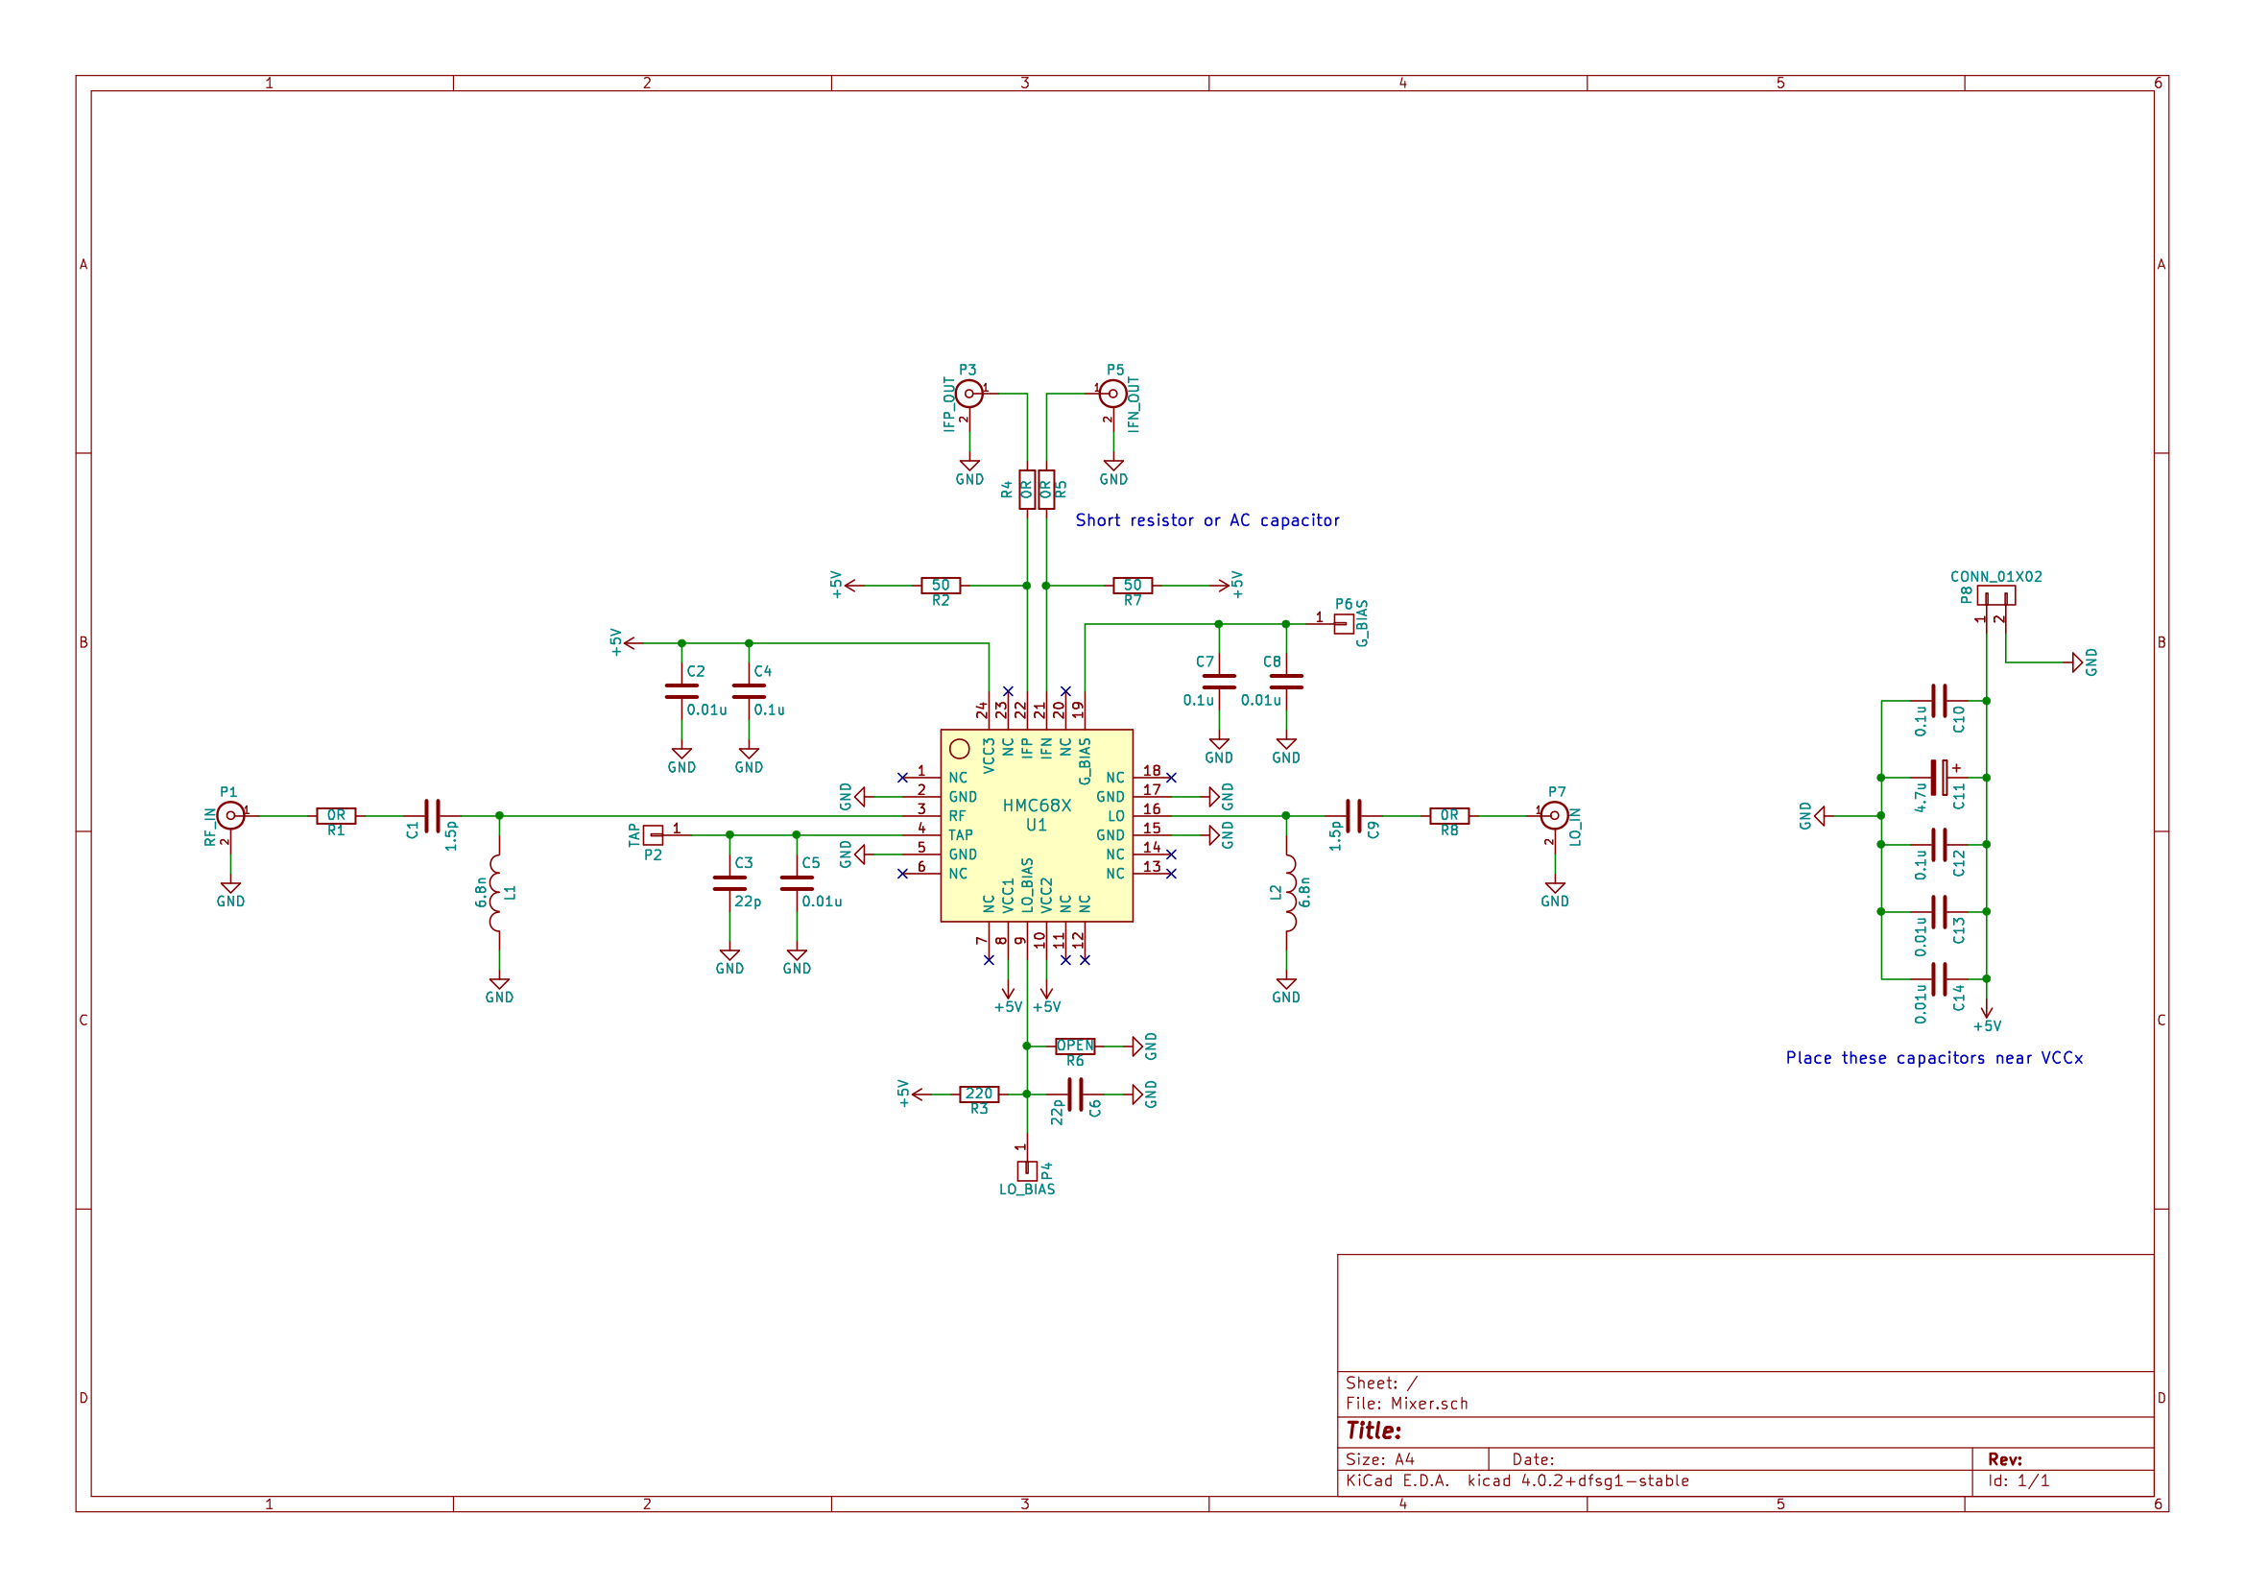

Slide 34
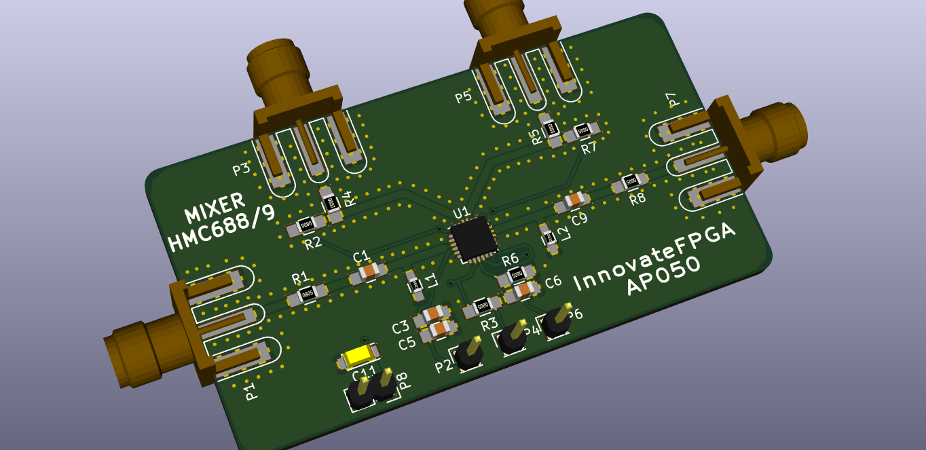

Slide 35
DAQ

Slide 36
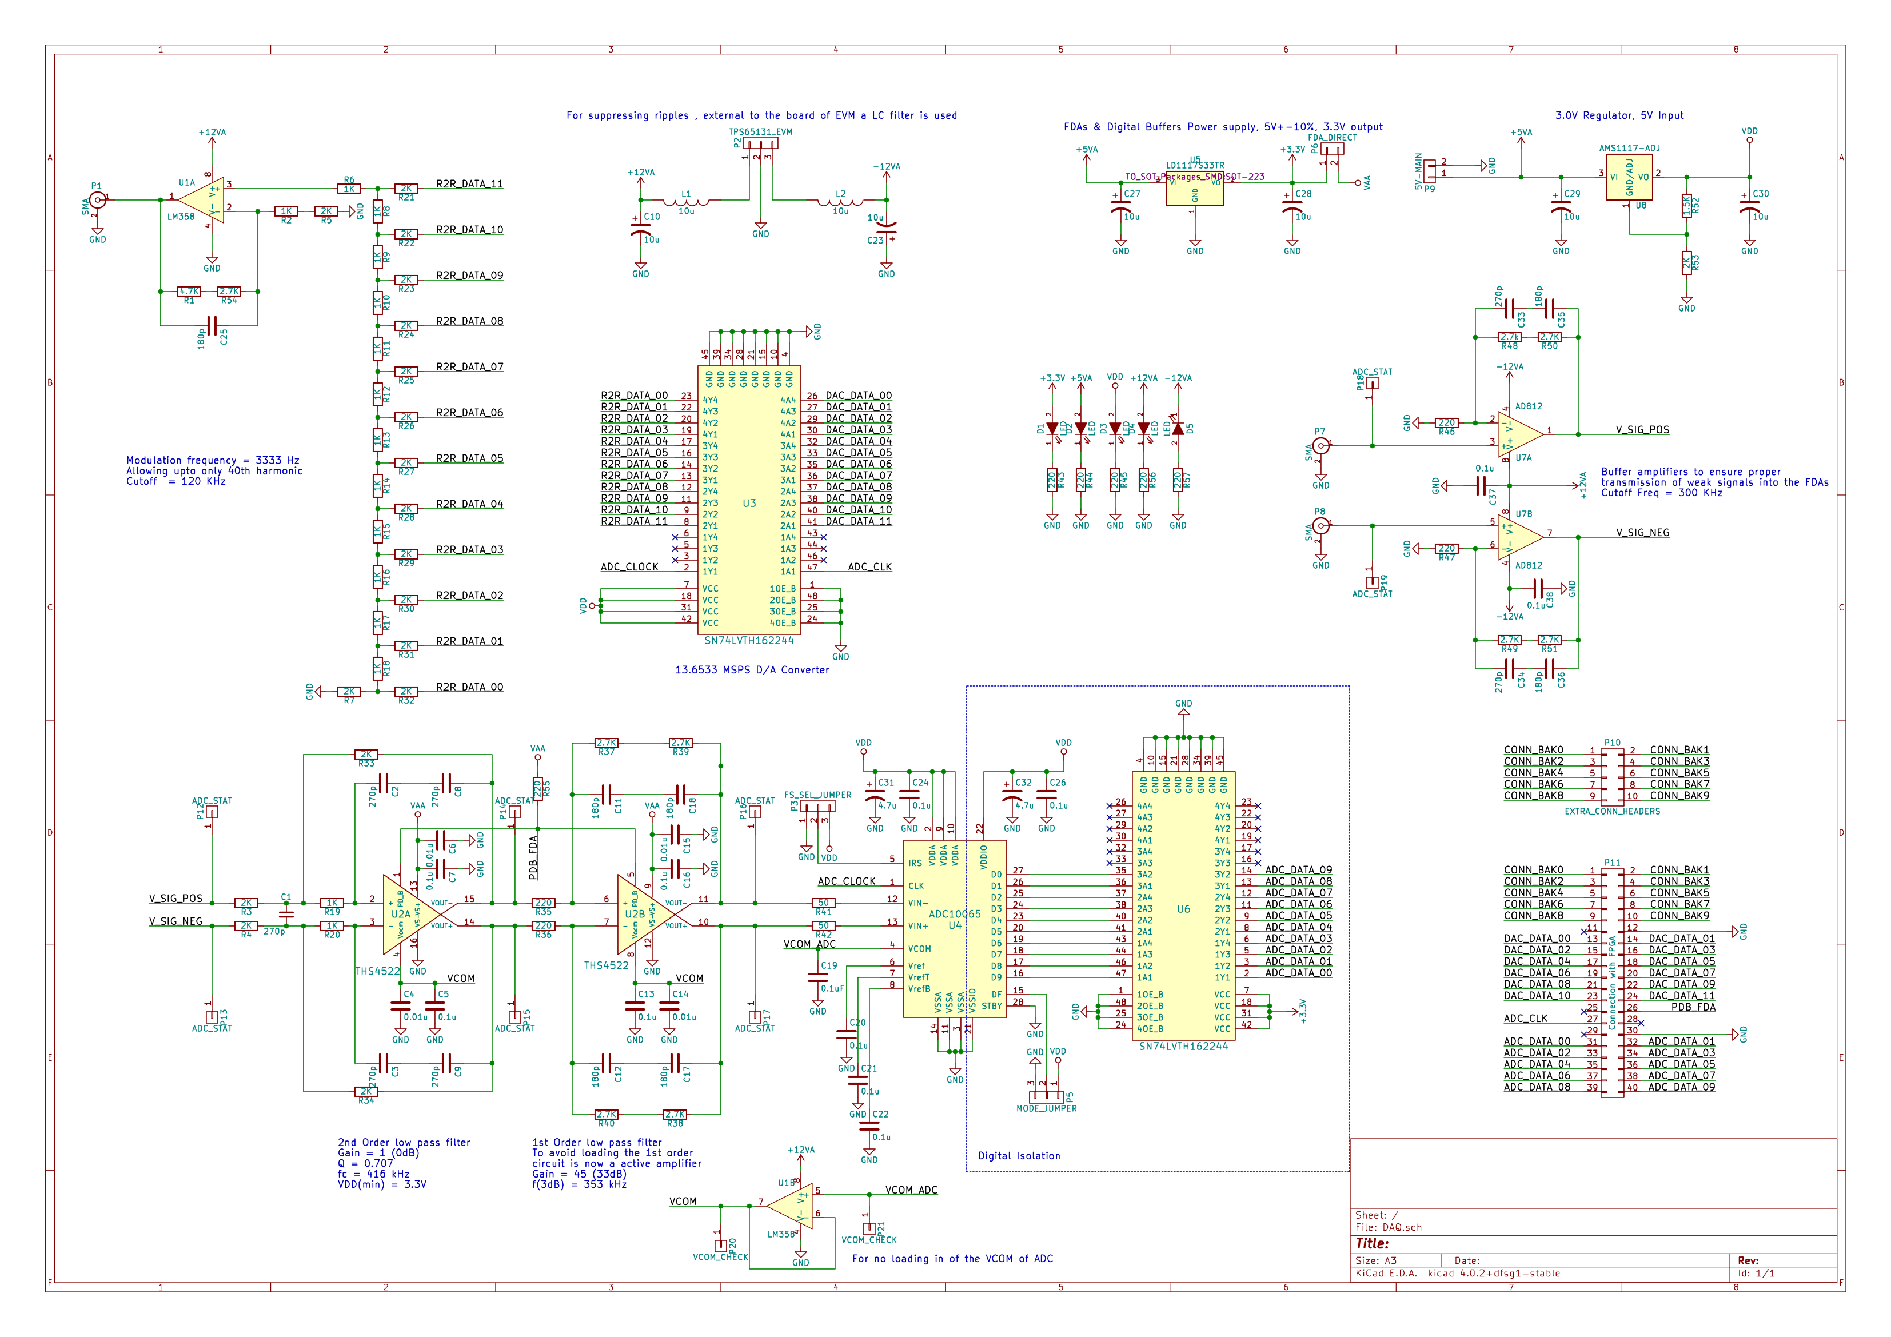

Slide 37
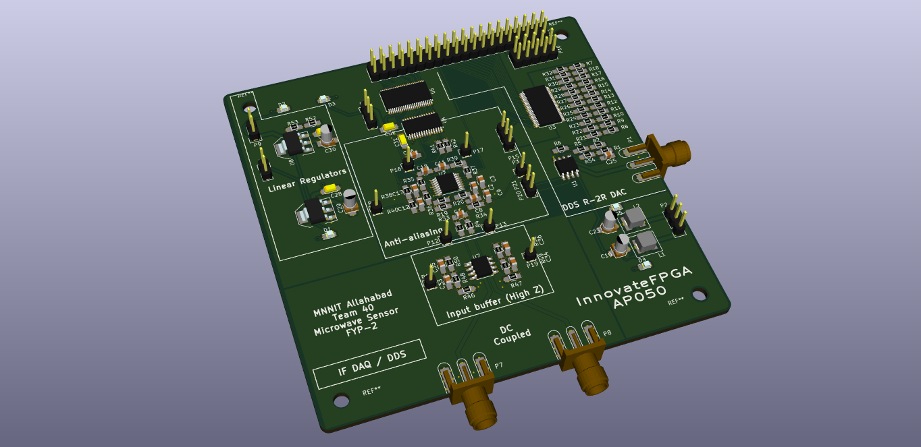

Slide 38
VCO

Slide 39
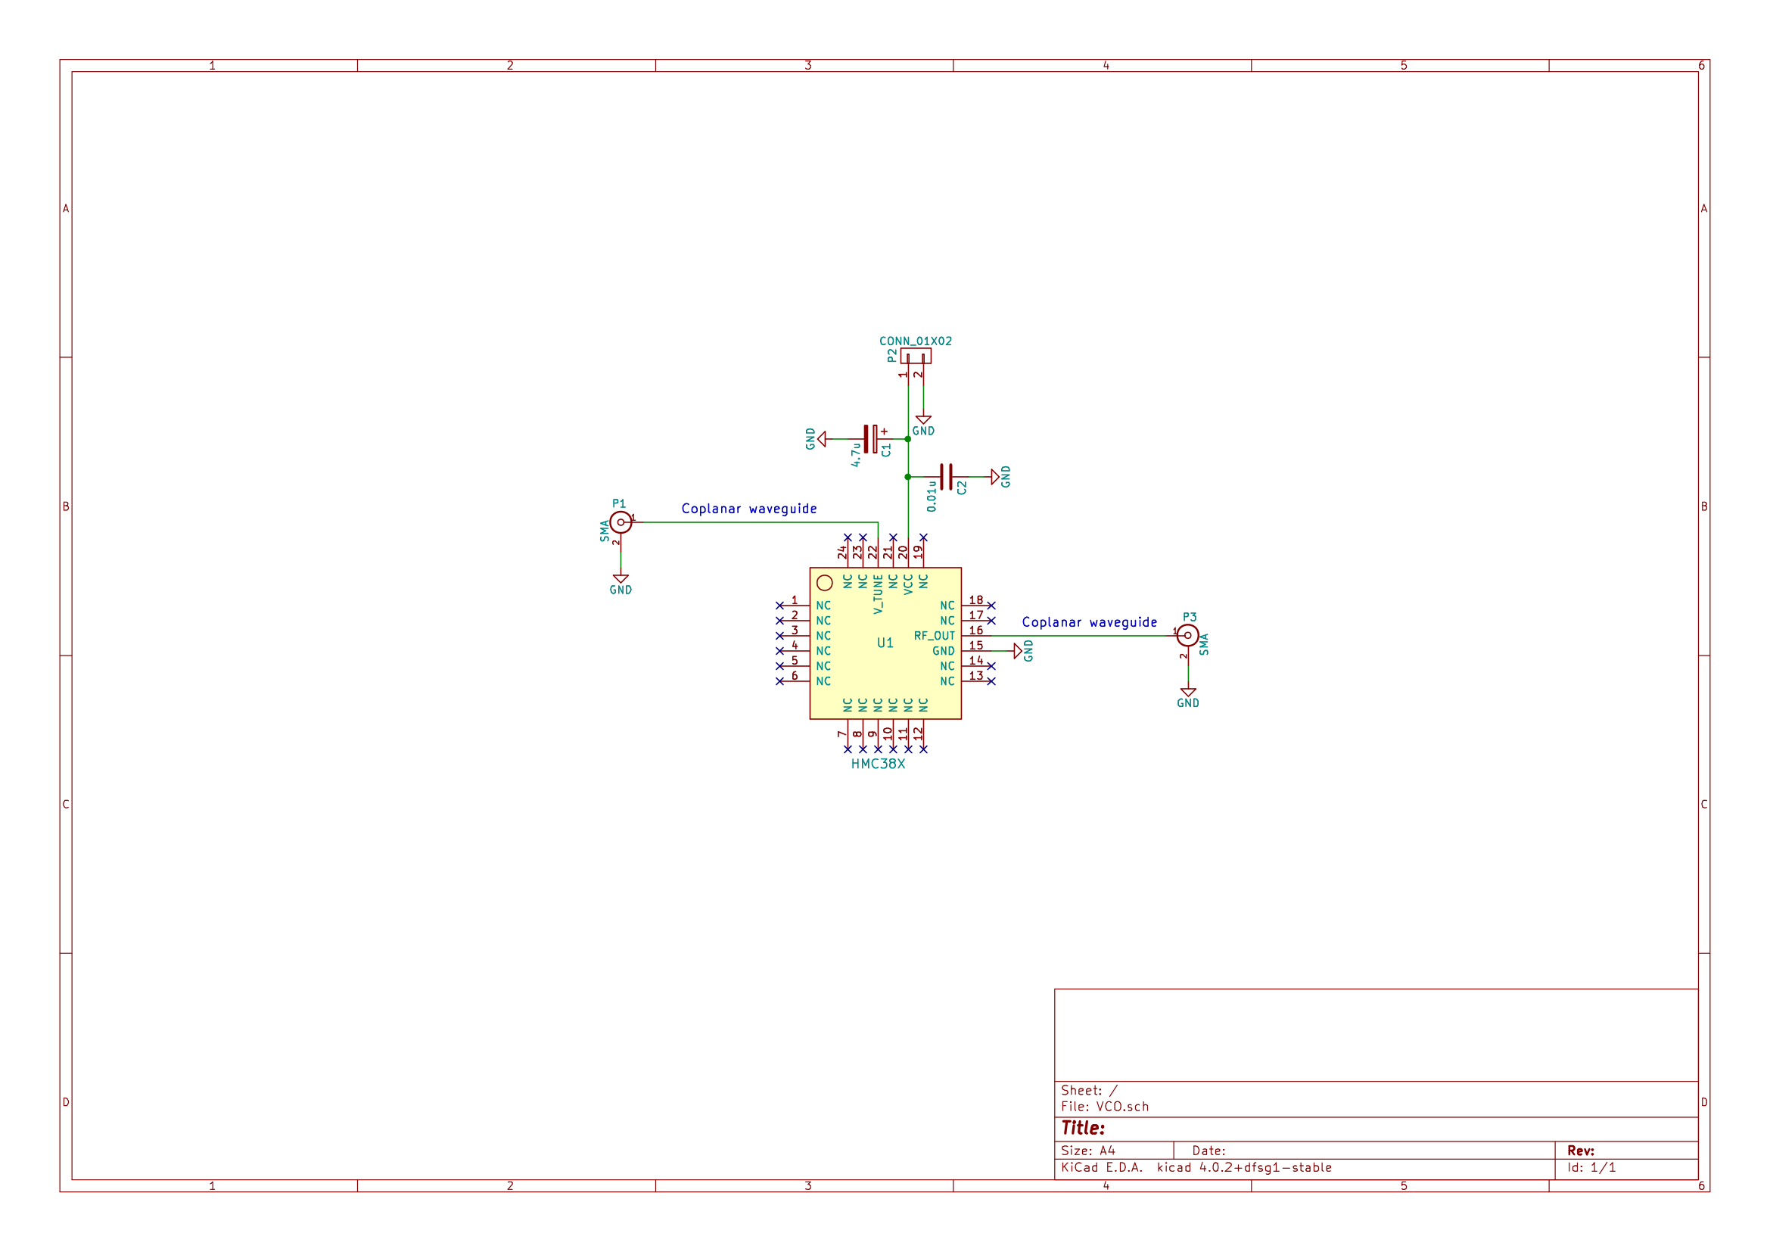

Slide 40
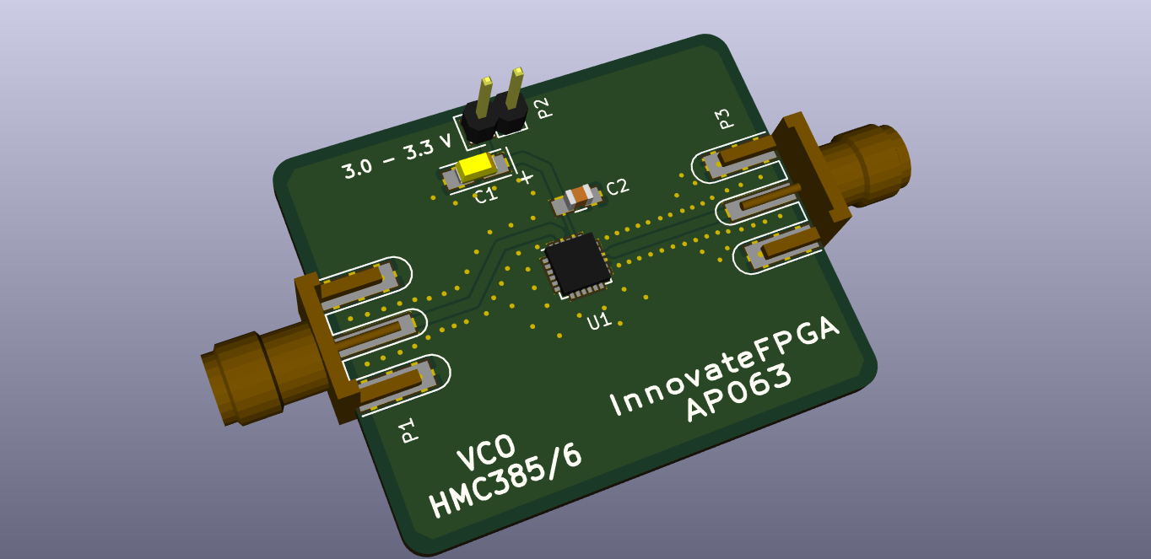

Slide 41
Single Patch Antenna Simulation
Designed for centre frequency – 2.5GHz
Material used – FR4 Epoxy (Dielectric constant = 4.4)
Required VSWR = Less than 2
Software tool used = ANSYS EMS (HFSS) 19.0
Solver = Terminal

Slide 42
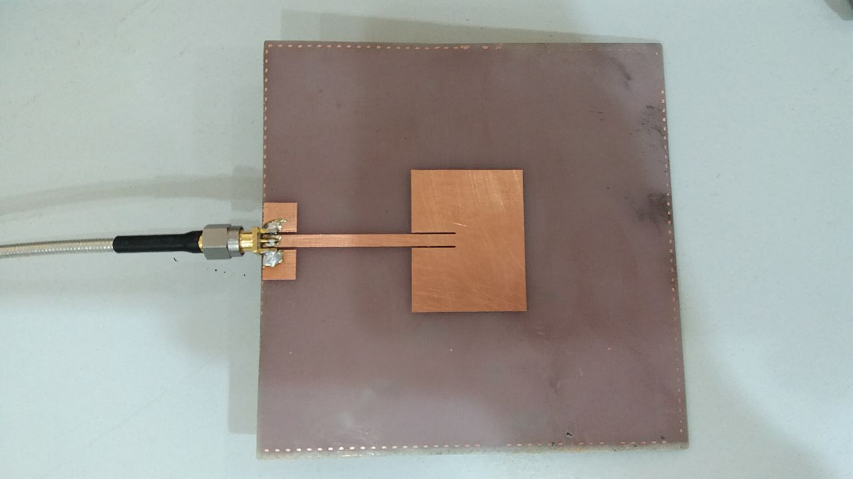
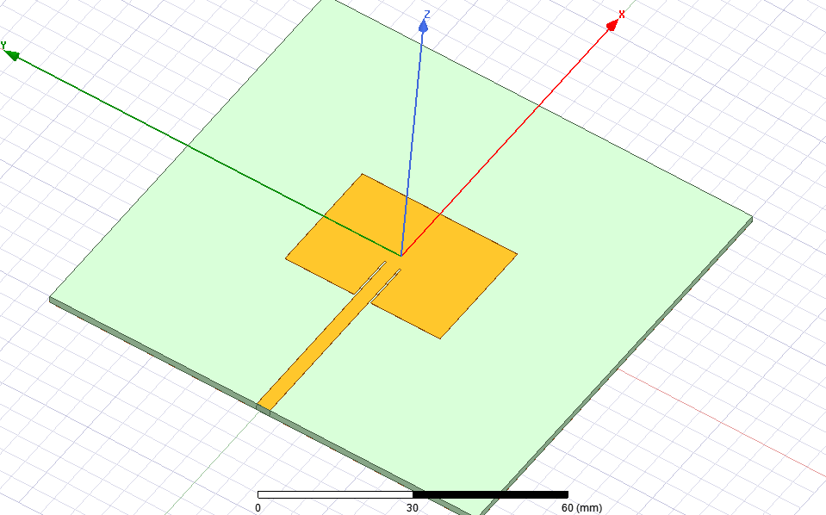
3D Image
Simulation Model
Fabricated Model

Slide 43
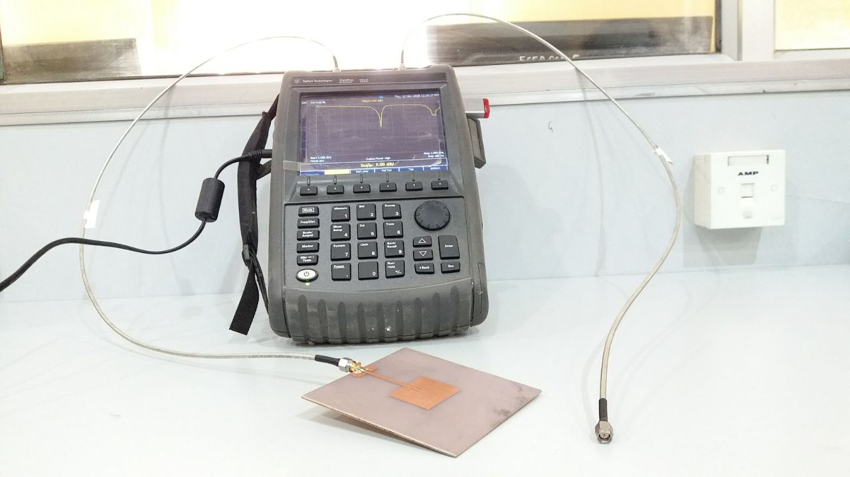
Experimental setup

Slide 44
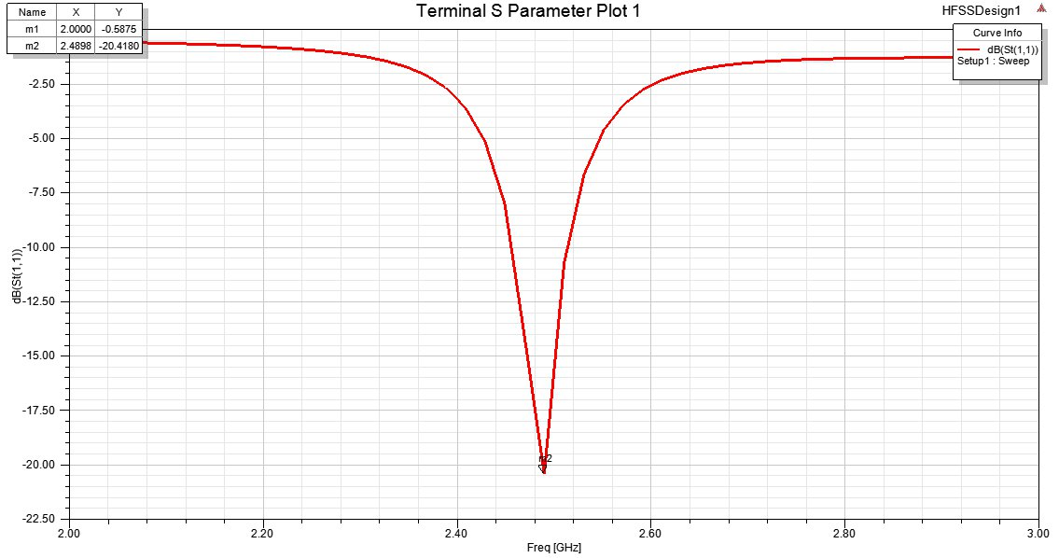
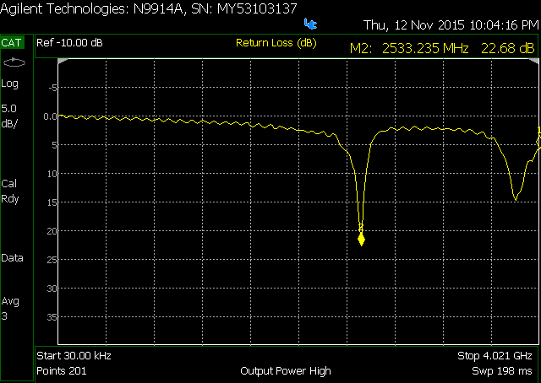
Return LOSS (dB)

Slide 45
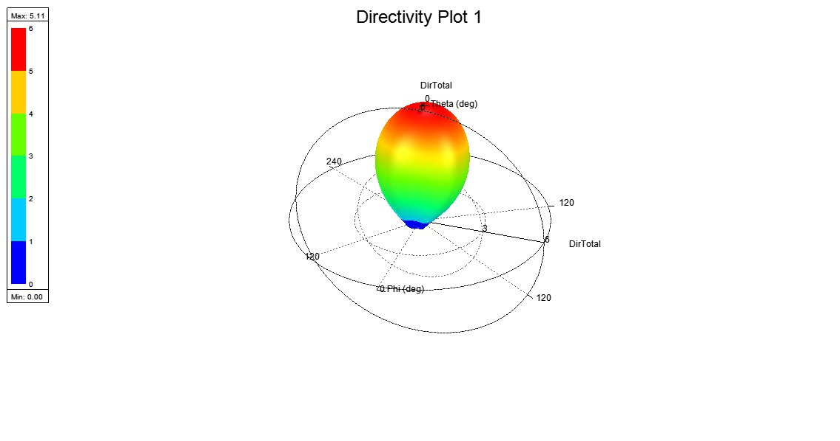
Directivity Plot

Slide 46
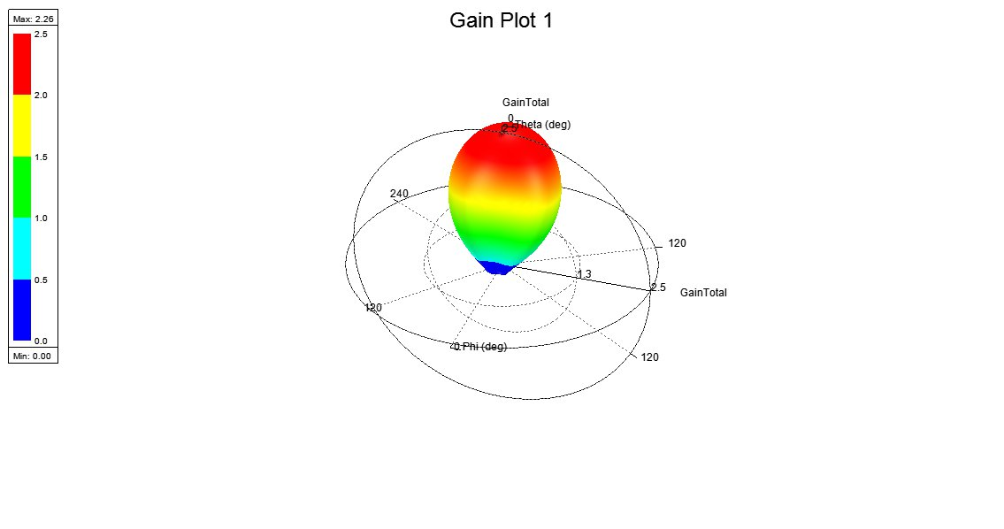
Gain Plot

Slide 47
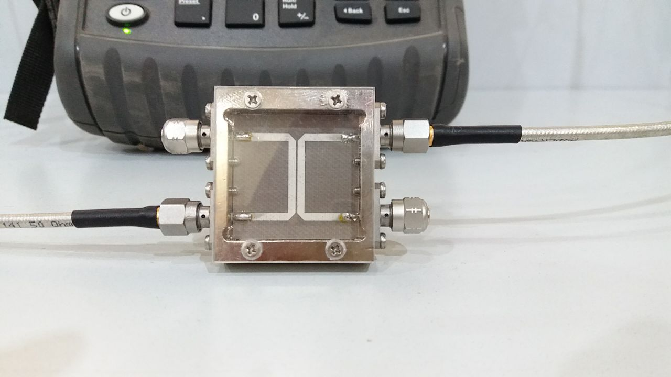
Directional COUPLER

Slide 48
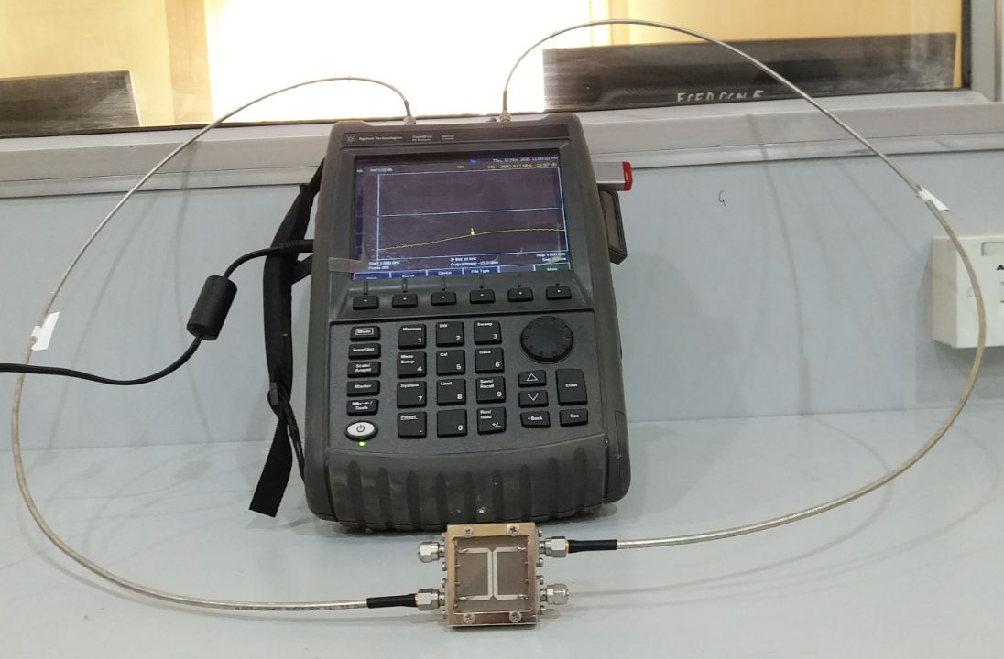
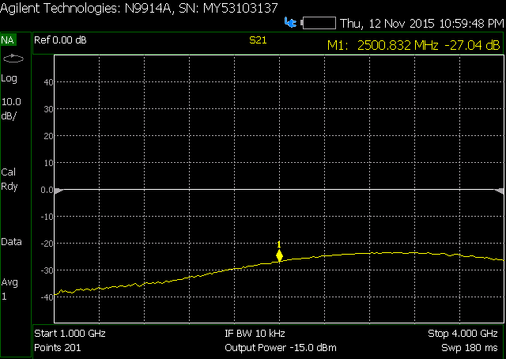
ISOLATION

Slide 49
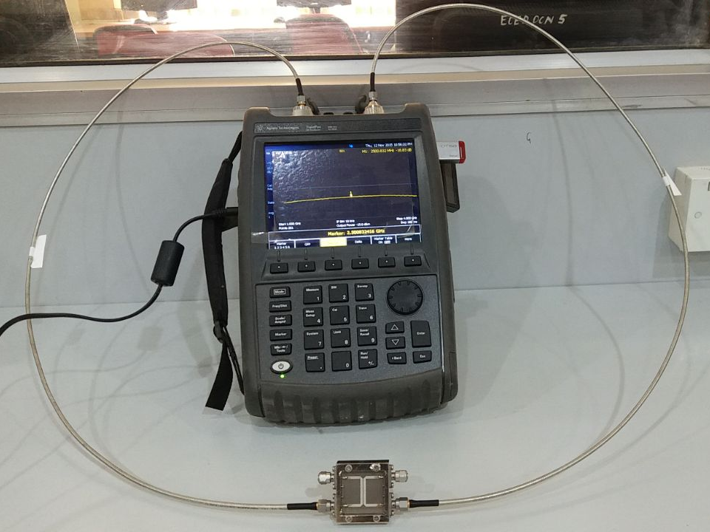
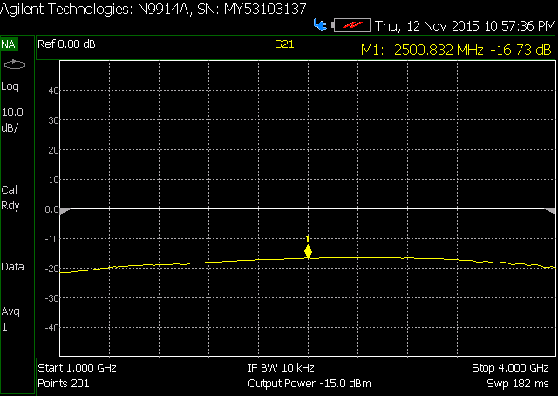
COUPLING

Slide 50
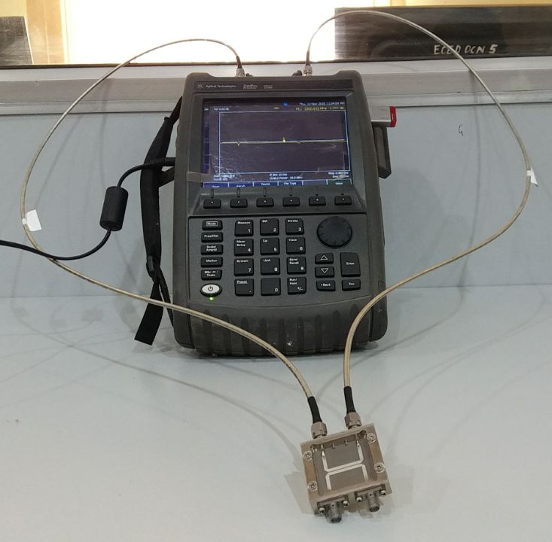
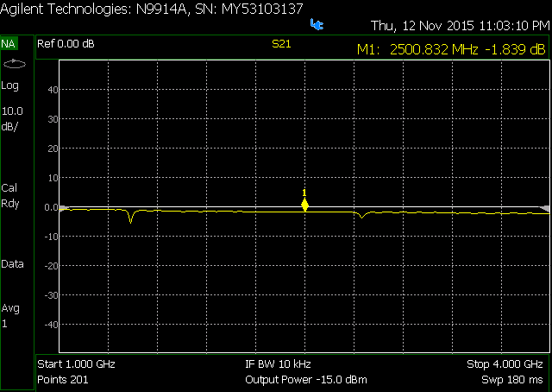
INSERTION LOSS

Slide 51
References
Gregory Charvat, Jonathan Williams, Alan Fenn, Steve Kogon, and Jeffrey Herd. RES.LL-003 Build a Small Radar System Capable of Sensing Range, Doppler, and Synthetic Aperture Radar Imaging. January IAP 2011. Massachusetts Institute of Technology: MIT OpenCourseWare, https://ocw.mit.edu. License: Creative Commons BY-NC-SA.
A. G. Stove, "Modern FMCW radar - techniques and applications," First European Radar Conference, 2004. EURAD., Amsterdam, The Netherlands, 2004, pp. 149-152.
H. Werfelli, K. Tayari, M. Chaoui, M. Lahiani and H. Ghariani, "Design of rectangular microstrip patch antenna," 2016 2nd International Conference on Advanced Technologies for Signal and Image Processing (ATSIP), Monastir, 2016, pp. 798-803.
A. Qureshi, M. U. Afzal, T. Tauqeer and M. A. Tarar, "Performance analysis of FR-4 substrate for high frequency microstrip antennas," 2011 China-Japan Joint Microwave Conference, Hangzhou, 2011, pp. 1-4.

Slide 52
What we plan to do next ?
After we get our boards fabricated, we would assemble the components and test it individually for satisfactory results. If there are any problems with the components we would modify the components on-board or re-design the board and again order for the fabrication.
Now using the DAQ board and FPGA board we would try to find the FFT of the IF signal. It would allow us to find the range.
All the results and process would be well documented in a final report.

Slide 53
Thank you

